Slide 1
APMS Nuts and Bolts
Emily Garmon, M.D.
Medical Director,
Hospital Pain Management Service
September 2, 2013
Notes:
Hospital wide education effort to improve hospital pain scores
It’s the right thing to do for patients and for institution

Slide 2
Preparation for Day on Service
Check OR list in the afternoon before you are on service and identify patients who will need blocks the following day
Call staff the night before with first starts
Discuss appropriate placement for first start blocks/epidurals
Notify staff to arrive early

Slide 3
APMS First Starts
Arrive at 6:00 AM
Pre-op and consent patients who will receive pre-op interventions first
Pre-op and consent patients who may receive post-op interventions
Page staff by 6:30 with first start epidural if staff has not arrived
Do not start epidural without staff present unless instructed to do so by staff
Lecture and 6:45 and staff will place remaining first start blocks
Notes:
Our obligation

Slide 4
Rounding
Page staff when lecture is finished and meet for rounds
Chart review
PCA and IV medication for breakthrough
Ketorolac and kidney function
Hydrocodone
Patient evaluation
Pain score overnight
Side effects
Determine if patient needs intervention
Inspect the patient’s back
Verify that the tubing is connected and intact

Slide 5
Patient Expectations
Communicate to patient what to expect with epidural
Bilateral knees and orthopedic revisions (48 hours)
Exploratory laparotomy (out when taking PO reliably)
Thoracic surgery (out when chest tube is removed)
Foley catheters per primary team
TAH/BSO (out POD #1)
Thoracic surgery (out POD #1 or when strict I&O no longer necessary)
Pain control after epidural removal
Hydrocodone for baseline pain
Ketorolac
IV PCA/intermittent dosing for breakthrough
Discuss adjuncts

Slide 6
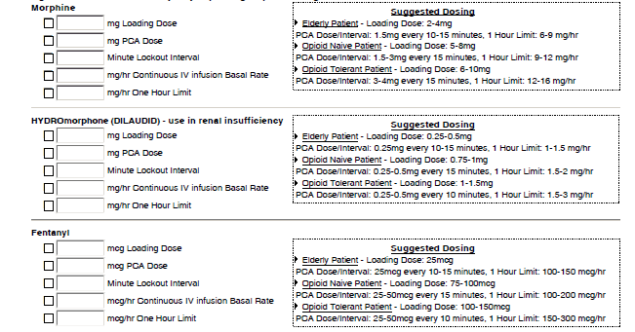
PCA Order Set
Peak DOA (hrs)
Morphine 30-60 3-4
Hydromorphone 15-30 2-3
Fentanyl 3-5 .5-1

Slide 7
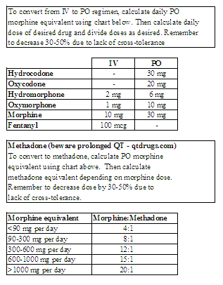
Practical Prescribing: Equianalgesic Dosing

Slide 8
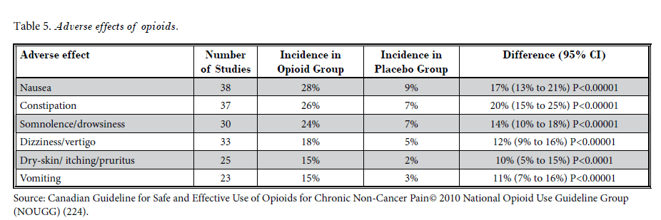
Adverse Effects of Opioids
*Manchikanti et al: ASIPP Guidelines for Responsible Opioid Prescribing
In Chronic Non-Cancer Pain: Part 1- Evidence Assessment, 2012.

Slide 9
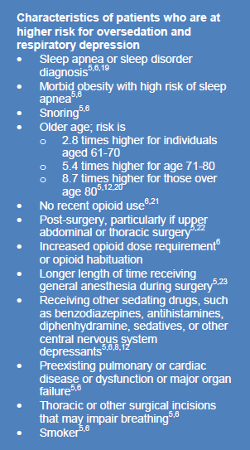
*Joint Commission Sentinel Event Alert #47: Opioid-Related Respiratory Depression in the Hospitalized Patient

Slide 10
Co Analgesics
Agents which enhance analgesic efficacy, have independent analgesic activity for specific types of pain, and / or relieve concurrent symptoms which exacerbate pain
Examples
Antidepressants
Tricyclic antidepressants
SSRI
Anticonvulsants
Gabapentin, pregabalin
Carbamazepine
Topical lidocaine patch
Ketamine – opioid sparing effects at subanesthetic doses
*Dahl, et al: An Expert Opinion on Postoperative Pain Management,
with Special Reference to New Developments, 2010
Notes:
Relaxation, massage, TENS, acupuncture

Slide 11
Recommendations for Adjuncts
Neuropathic pain
Gabapentin, pregabablin
Add nortriptyline 10 mg PO QHS if patient reports poor sleep
Add duloxetine if patient has depression-type symptoms and neuropathic pain
Musculoskeletal pain (i.e., from intraoperative malpositioning)
Add benzodiazepine (cautiously) for muscle spasms
Add muscle relaxants (brief time course) if unresponsive or intolerance to benzodiazepines

Slide 12
Intra-op Discussion of Pain Management
Review patient chronic pain regimen
Make recommendations for conversion to IV while NPO
Make sure primary team has plan if APMS not involved

