Slide 1
Belmont Rapid Infuser™
Kent F. Elliott, m.D.

Slide 2
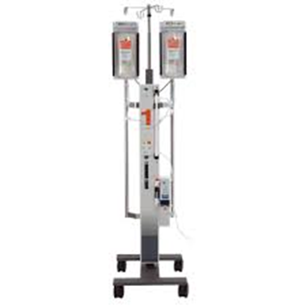
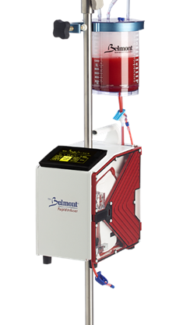
Belmont Rapid Infuser
Q1
Compared to conventional bag-squeezer RI systems, name three features which make the Belmont a “smart” system.

Slide 3
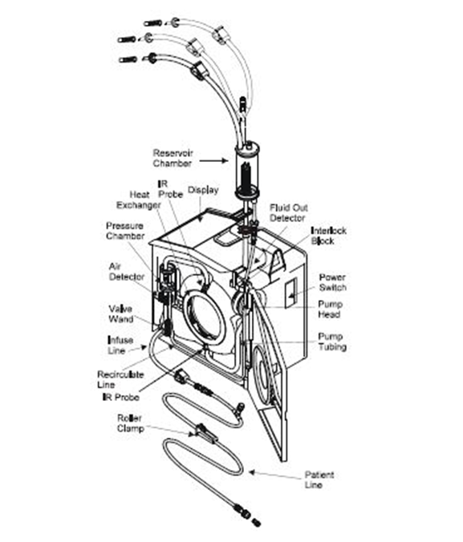
Belmont Rapid Infuser
A1
The presence of a microprocessor providing protective feedback loops ensuring safe IV fluid flow. Included are two air bubble sensors, a pressure transducer, two temperature probes, a pump flow rate sensor, an open door detector and a valve activation sensor.

Slide 4
Belmont Rapid Infuser
Q2
Safe heating of infusates occurs by what mechanism?

Slide 5
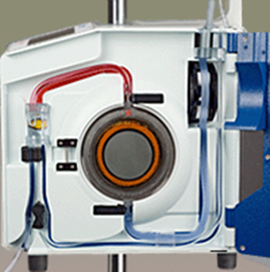
Belmont Rapid Infuser
A2
Use of an Induction heat exchanger involving stainless steel plates.

Slide 6
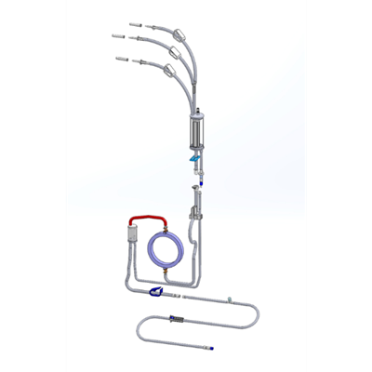
Belmont Rapid Infuser
Q3
After loading the disposable set, how is the unit and patient line primed?

Slide 7
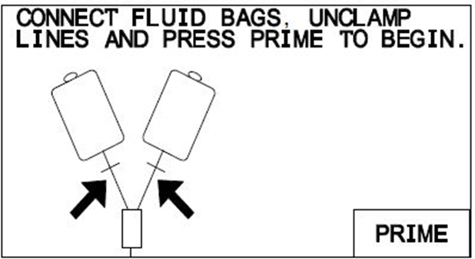
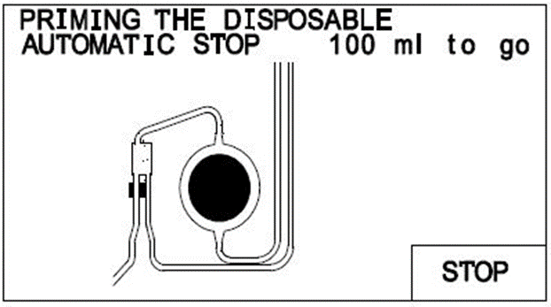
Belmont Rapid Infuser
A3
After connecting fluid bags and unclamping clamps, press PRIME to prime the set and PT LINE PRIME to prime the patient line.

Slide 8
Belmont Rapid Infuser
Q4
Sustained flow rate using the BRI is limited by an FDA-approved factory setting of what pressure level?

Slide 9
Belmont Rapid Infuser
A4
300mmHg. (It is adjustable down to 100mmHg using the settings menu.)

Slide 10
Belmont Rapid Infuser
Q5
What is the factory set default Bolus volume? How is it changed?

Slide 11
Belmont Rapid Infuser
A5
200ml; Change the bolus volume using the parameters Setup screen or by pressing and holding the BOLUS key in the Infuse screen. Releasing the Bolus key will start the infusion at the selected volume.

Slide 12
Belmont Rapid Infuser
Q6
What does “RECIRC” do?

Slide 13
Belmont Rapid Infuser
A6
Recirculates fluid, warms and removes air in the main system at a preset rate of 200ml/min. It automatically stops and beeps after 5 minutes. It may contribute to hemolysis of transfused RBC’s.

Slide 14
Belmont Rapid Infuser
Q7
Identify two reasons to open the door of the BRI.

Slide 15
Belmont Rapid Infuser
A7
To purge air manually at the AIR DETECTOR below the PRESSURE CHAMBER and secondly in case of Emergency Manual Operation (unit failure).

Slide 16
Belmont Rapid Infuser
Q8
Explain the process of Emergency Manual Operation in the event of power failure.

Slide 17
Belmont Rapid Infuser
A8
Switch to STANDBY on the circuit breaker switch, open the door, remove the infuse line from the valve wand. The remainder of the disposable set may be left in place. Next apply pressure at the fluid bag to aid flow. Make certain that the bag clamps and patient line are open. Take care that excessive force is not used on the bag to avoid rupturing the disposable set.

Slide 18
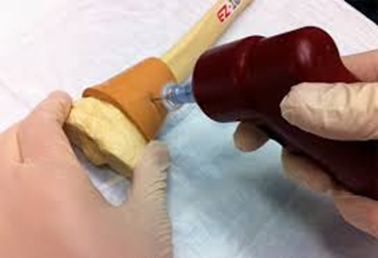
Belmont Rapid Infuser
Q9
What is the max flow rate in ml/min and the IV catheter equivalent when using an intraosseous catheter (I/O) at standard 300mmHg pressure?

Slide 19
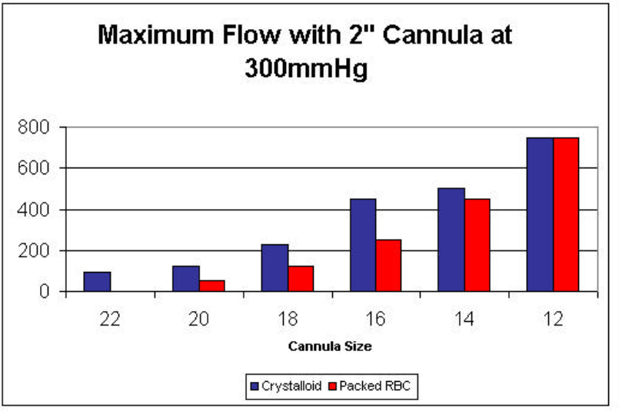
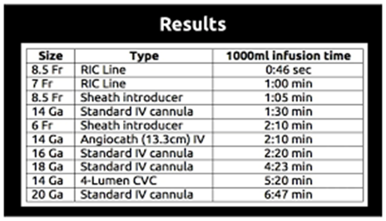
Belmont Rapid Infuser
A9
Humeral I/O: 84ml/min (equivalent to a standard 20 ga. Catheter)
and Tibial I/O: 13 ml/min; which is less than a 22ga. catheter.

Slide 20
Belmont Rapid Infuser
Q10
Name four reasons for which the Divert Valve would close the infusate line to the patient and thereby recirculate infusate to the reservoir?

Slide 21
Belmont Rapid Infuser
A10
Excess air in line
Open door
Over pressure
Power failure
Fluid out
Line kinked
Over temperature
Heating fault

Slide 22
Belmont Rapid Infuser
Q11
Name the three products to never infuse in the Belmont Rapid Infuser.

Slide 23
Belmont Rapid Infuser
A11
Platelets
Cryoprecipitate
Granulocyte infusions

Slide 24
