Slide 1
APMS Ultrasound
For vascular access

Slide 2
APMS Sonosite
Higher resolution, superior image quality
High utilization by APMS for ERAS patients, catheter placements, preop and postop blocks
Now, occasionally sought after for vascular access, also

Slide 3
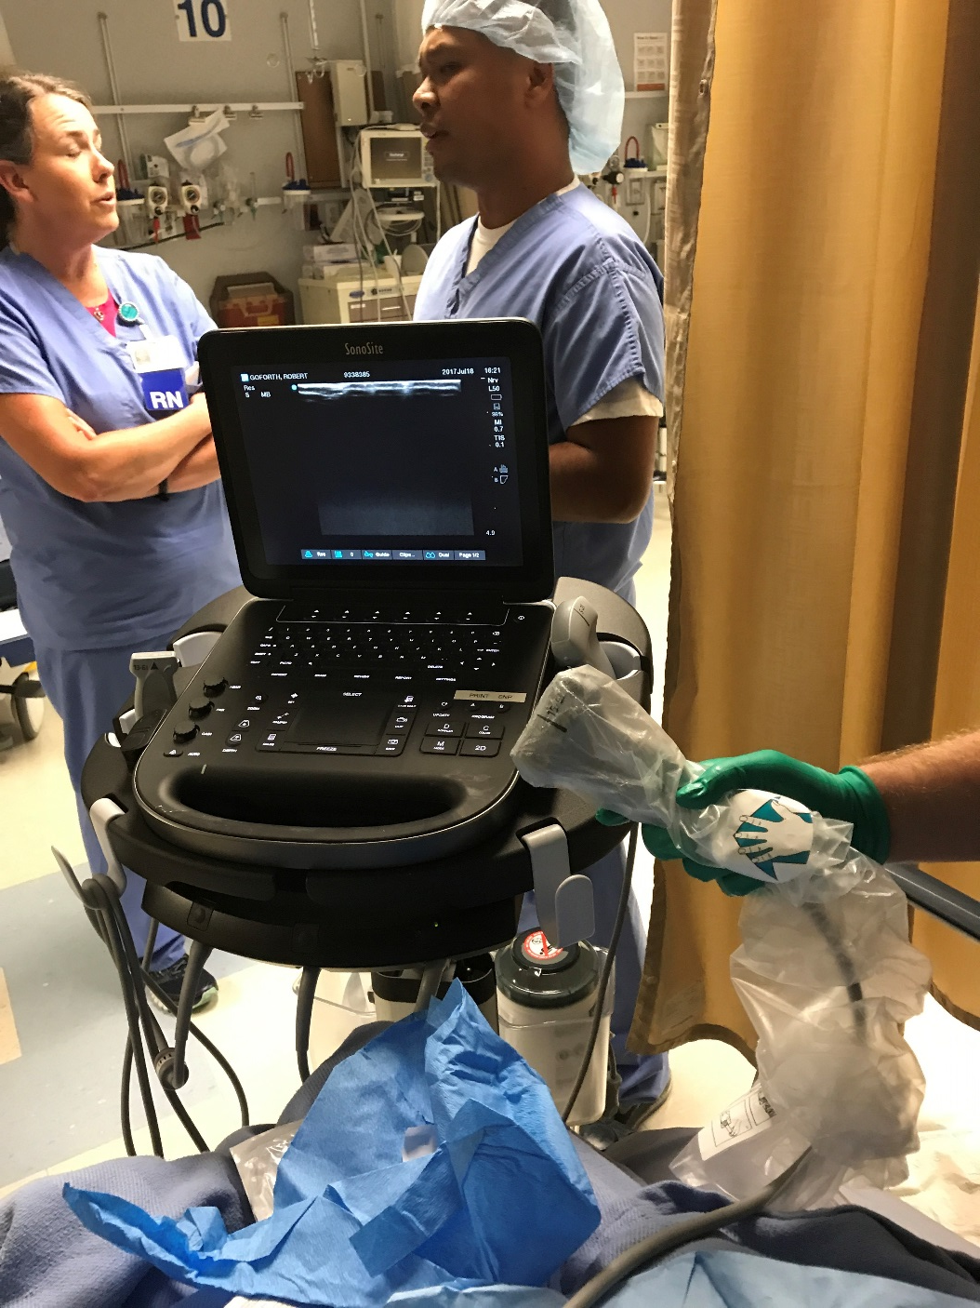
APMS Nurse, Beeper 1880
Knows the location, anticipated availability
Knows how to enter patient data to assure billing and uploading to PACS
Knows the care and cleaning of the probe
e.g. Probe covers, non-damaging cleaning wipes (NO Chloraprep)
Reliably maintains the security of the Sonosite, so it does not wander to other departments indefinitely

Slide 4
APMS Sonosite
If needed, please page the
APMS Nurse, Beeper 1880
In house, until 2300.
Phillips machines should be available after hours.

Slide 5
If a functional ultrasound is not available
Fair and Consistent Culture process:
MIDAS,
for reporting of patient safety
and quality of care concerns
2) Email to BBV

Slide 6
MIDAS - How To

Slide 12
Email BBV.
Reviewed at the monthly Anesthesia QIC

